Slide 1

Web scraping and Research Automation BY Kamuju Vinay HU21CSEN0300505
Gandhi Institute of Technology and Management (Deemed to be University) Accredited by NAAC with A++ Grade Department of CSE-AIML

Slide 2
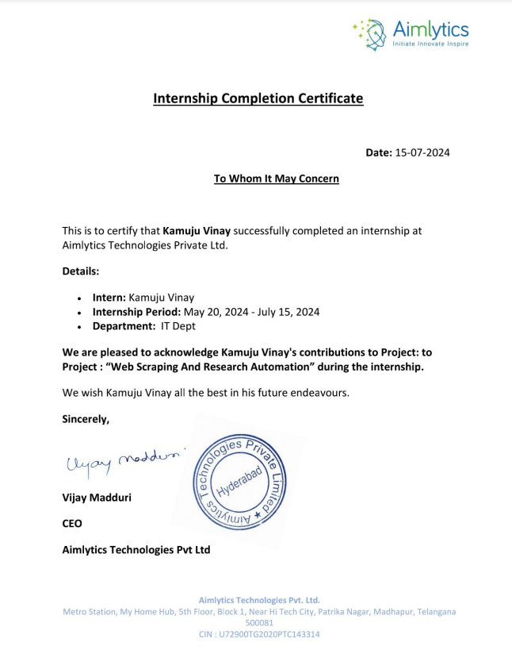

Slide 3


Agenda
LangChain | 1 |  | Text splitters | 6
LLM Chain | 2 |  | Embeddings | 7
Retrieval-Augmented Generation | 3 |  | Vector Store | 8
RAG Architecture | 4 |  | Web Scrapping | 9
Document Loaders | 5 Research automation 10

Slide 4
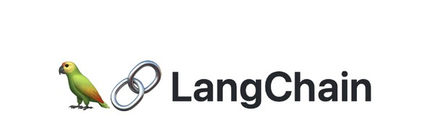
What is
Lang Chain is an open-source framework that enables developers to integrate large language models with external components to build advanced AI-powered applications. It streamlines the process of combining LLMs with other tools and systems.
?

Slide 5
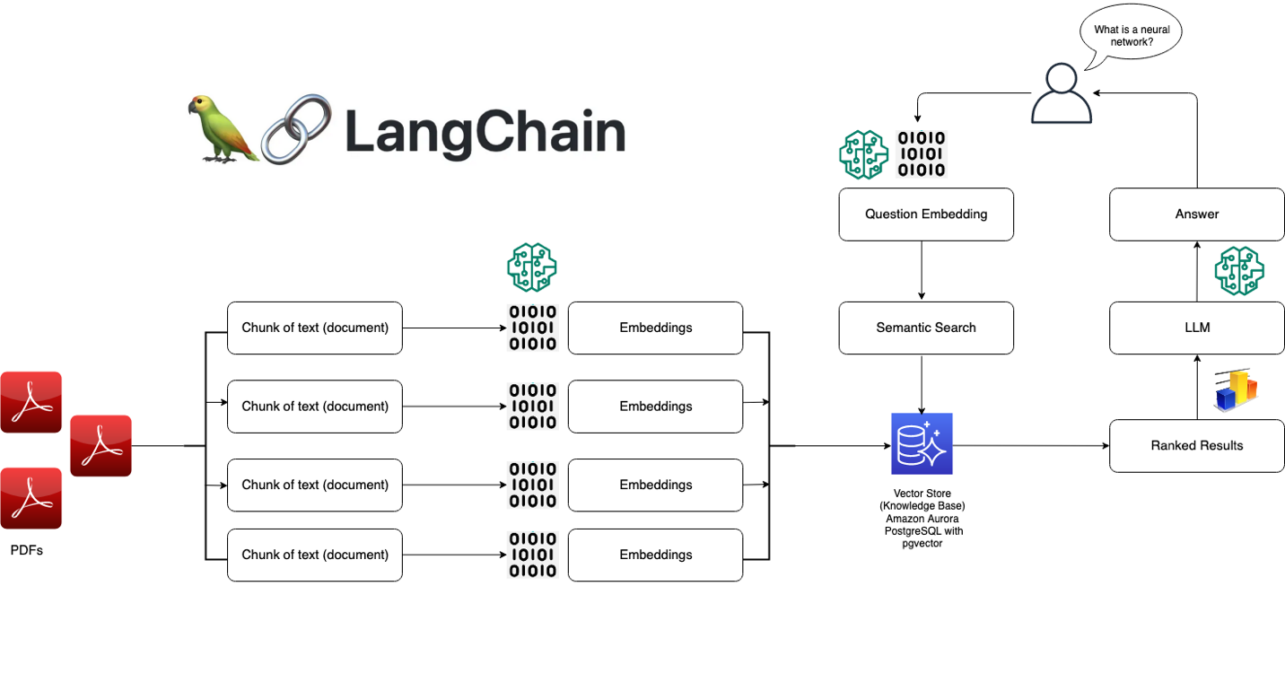

Slide 6
A large language model (LLM) is an AI system trained on vast text data to understand and generate human-like language. It excels in tasks like conversation, text generation, and contextual understanding.
What is LLM?

Slide 7
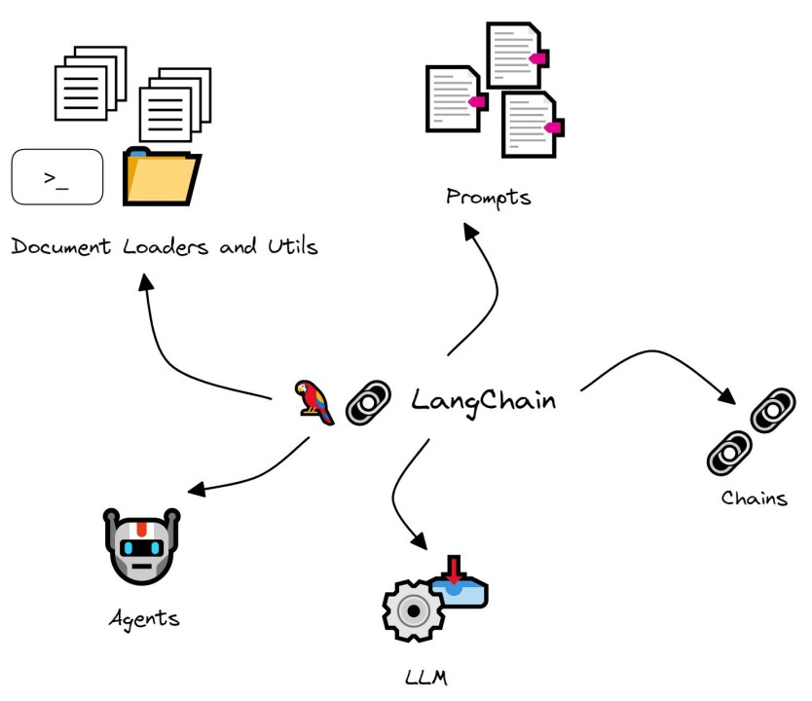
LLMChain
The LLMChain consists of a PromptTemplate, a language model, and an optional output parser. For example, you can create a chain that takes user input, formats it with a PromptTemplate, and then passes the formatted response to an LLM.

Slide 8
Retrieval-Augmented Generation (RAG) enhances LLMs by integrating external, up-to-date data. It addresses the limitation of static knowledge by retrieving relevant information and incorporating it into the model's responses. This approach improves the accuracy and relevance of the answers provided by the model.
Retrieval- Augmented Generation

Slide 9
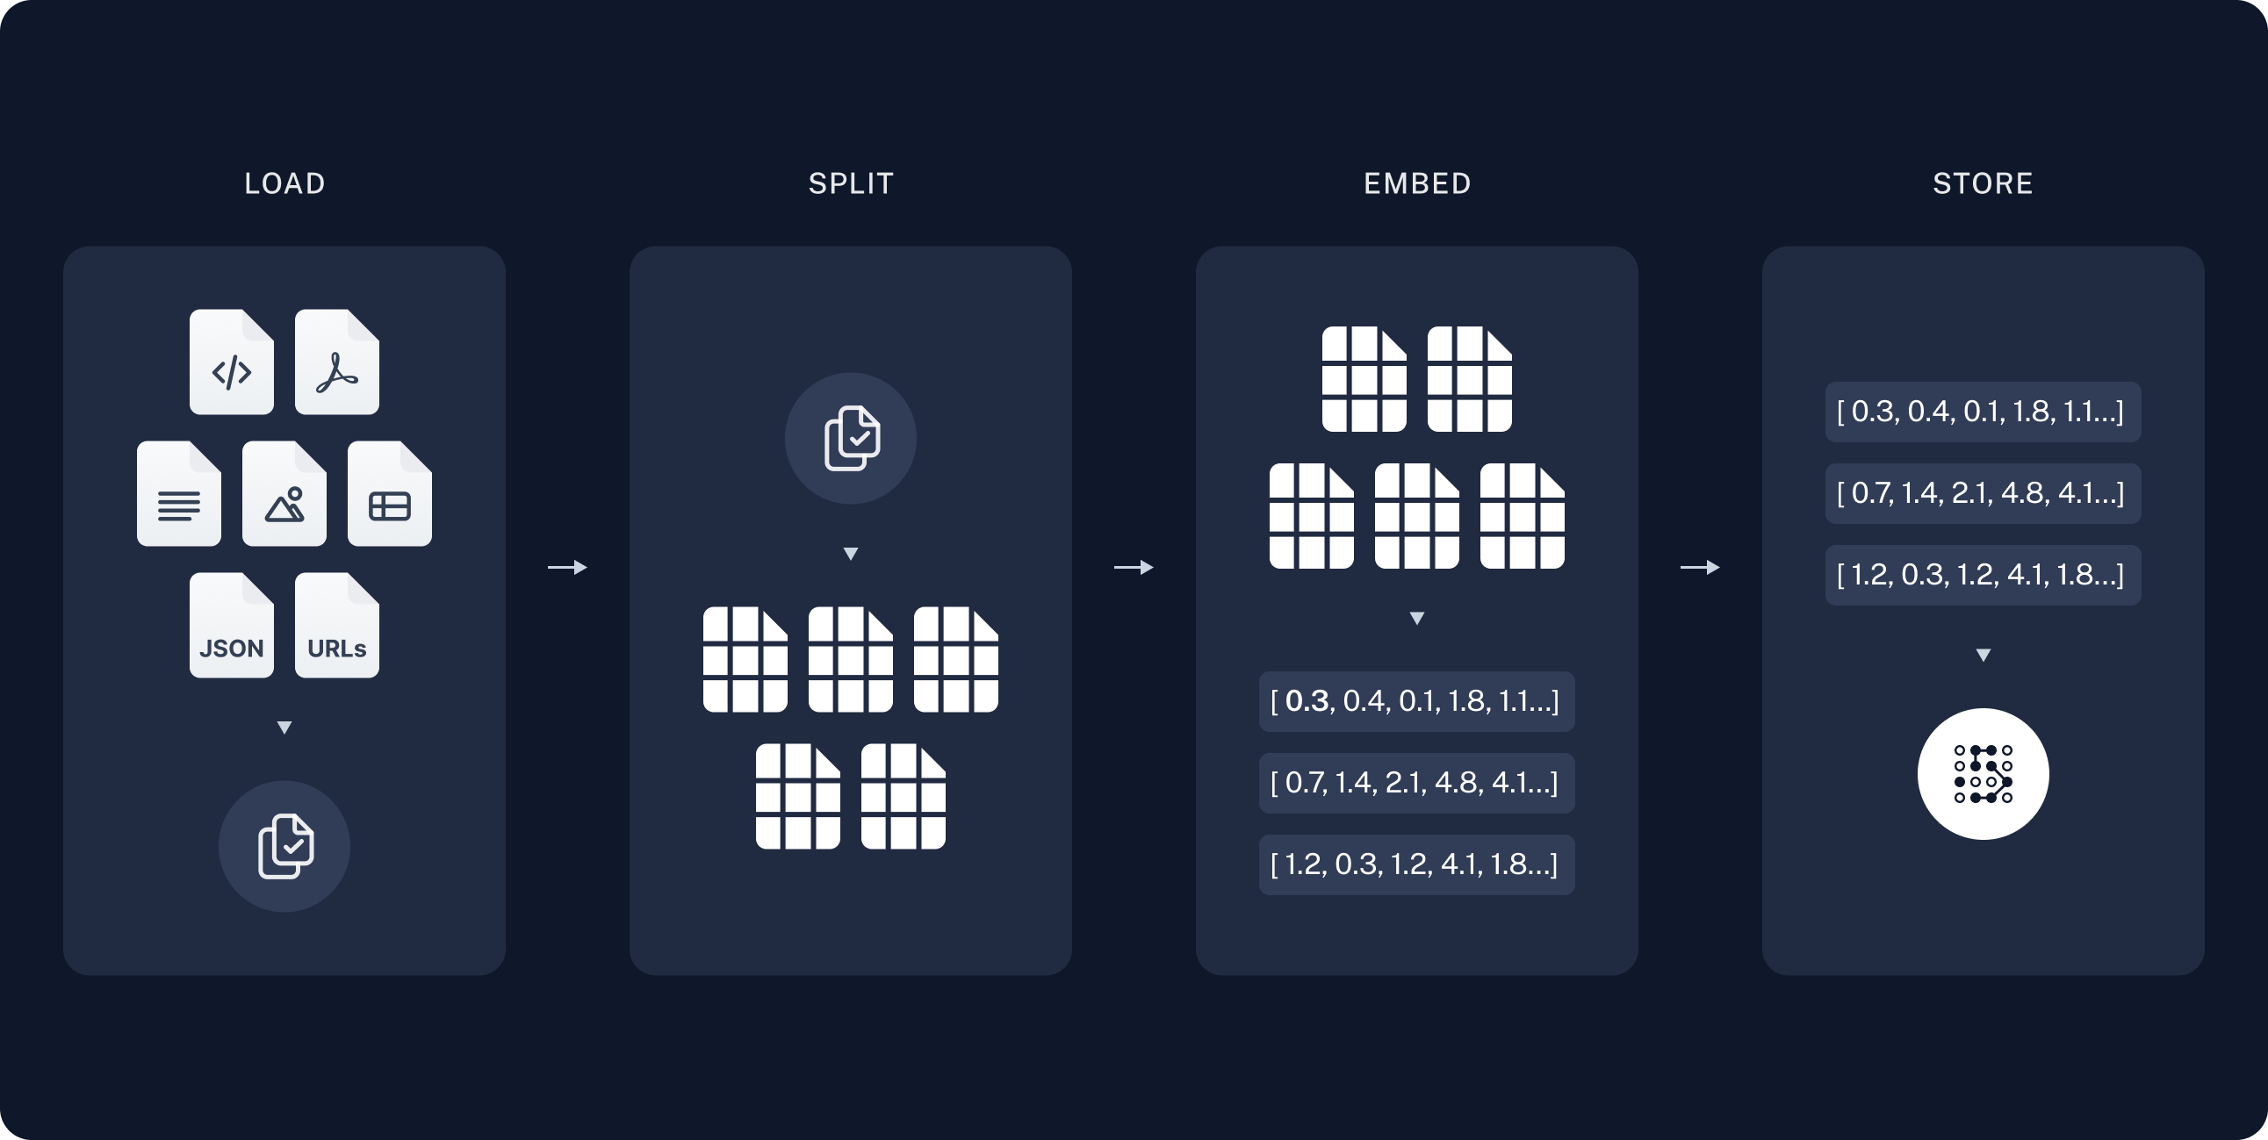
RAG
Architecture

Slide 10
Document Loaders
The load() method in Langhian's TextLoader class is used to convert raw text into a format that the language model can work with. When you call load(), it processes the provided document content and prepares it for integration into the language model pipeline. This step is essential for incorporating external or up-to-date information into your AI applications, allowing the model to access and utilize this data effectively.

Slide 11
Text Splitters
Text splitters are used to divide large documents into manageable chunks for processing by language models. They help in breaking down lengthy texts into smaller, coherent segments, making it easier for models to handle and analyze the content effectively. By splitting text into sections or sentences, splitters improve the model's ability to generate accurate responses and maintain context. This approach is crucial for managing extensive documents and ensuring relevant information is processed efficiently.

Slide 12
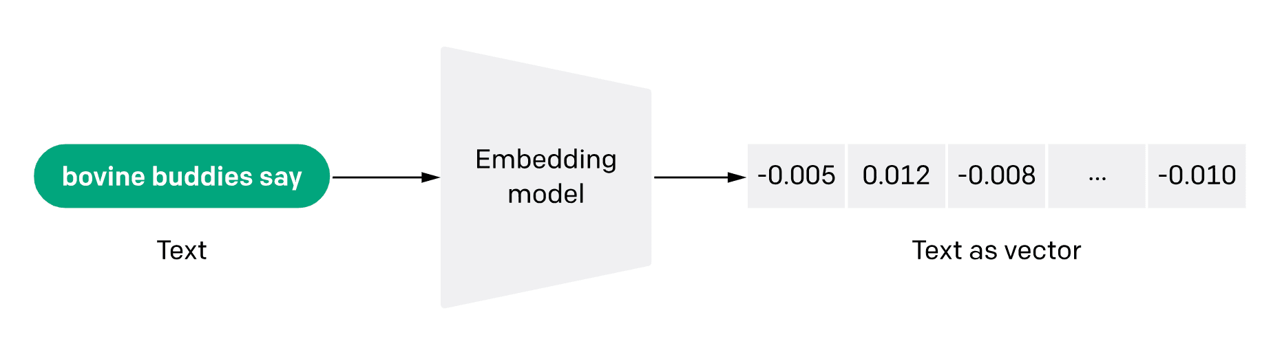
Text embedding models
Text embeddings are numerical representations of text data that capture semantic meaning. They convert words or phrases into dense vectors in a high-dimensional space, allowing models to understand and process textual information based on meaning rather than raw text. Embeddings facilitate various tasks such as text classification, similarity searches, and information retrieval by enabling models to work with numerical data efficiently. This approach enhances the model's ability to interpret and respond to complex queries effectively.

Slide 13
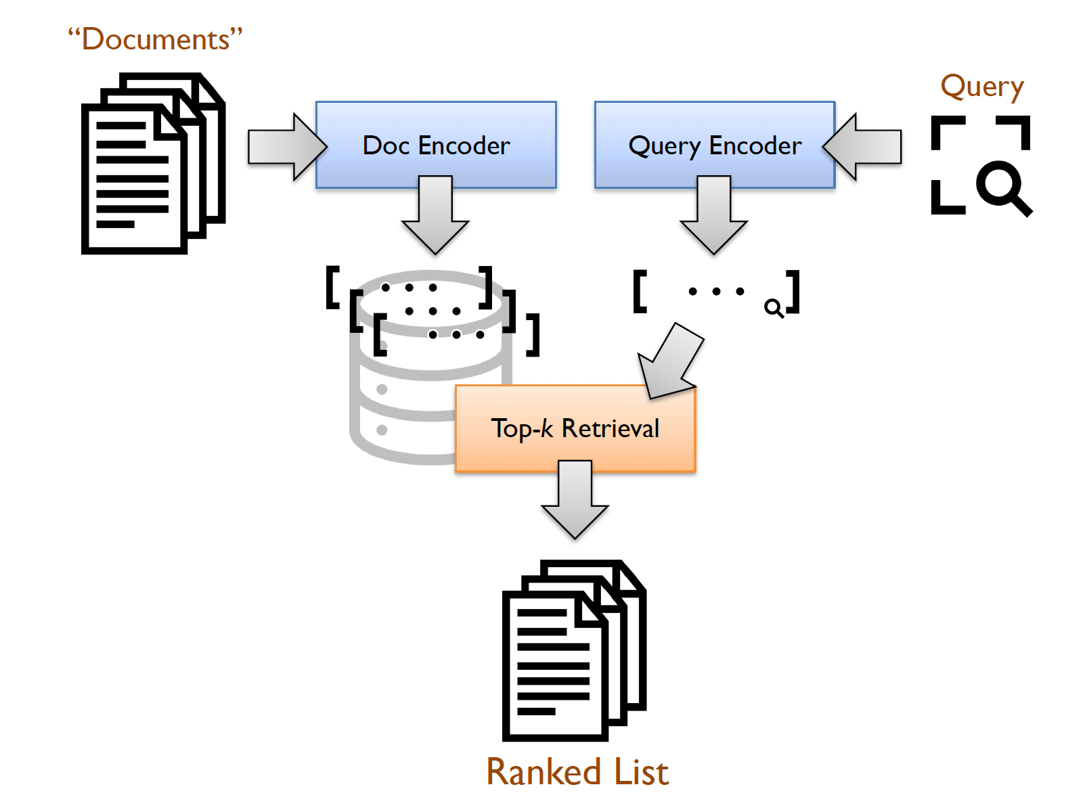
Vector stores
One of the most common ways to store and search over unstructured data is to embed it and store the resulting embedding vectors, and then at query time to embed the unstructured query and retrieve the embedding vectors that are 'most similar' to the embedded query. A vector store takes care of storing embedded data and performing vector search for you.

Slide 14
Web Scraping
BeautifulSoup, with the HTML parser, simplifies web scraping by parsing HTML documents. Start by retrieving web content using libraries like requests. Then, create a BeautifulSoup object with the HTML parser to parse the content. Use BeautifulSoup methods to navigate and extract specific data from the parsed HTML. This approach makes it easy to gather and structure information from websites efficiently.

Slide 15
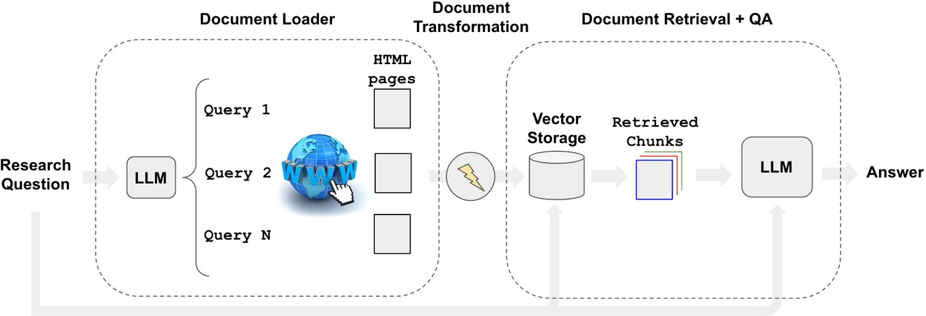
Related to scraping, we may want to answer specific questions using searched content.
We can automate the process of web research using a retriever, such as the WebResearchRetriever.
Research automation

Slide 16
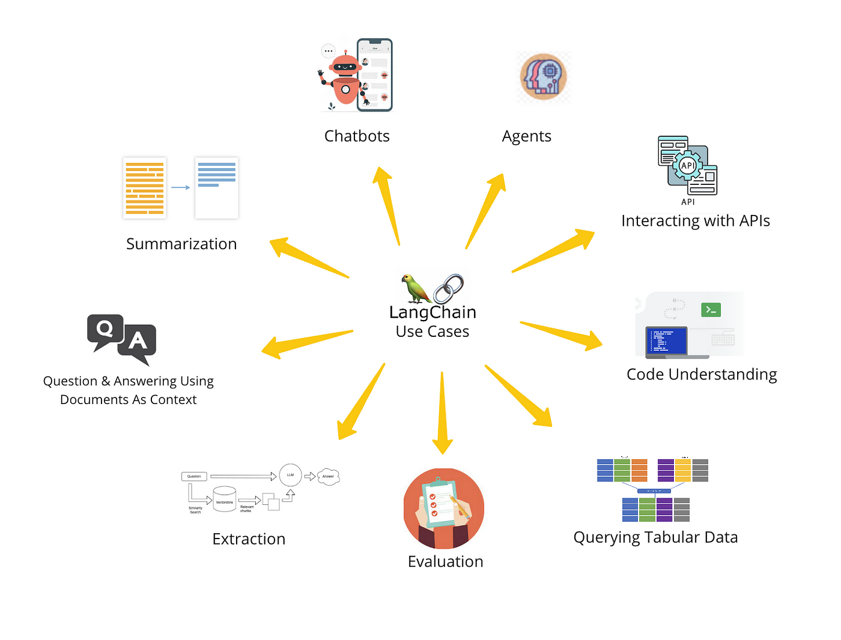
Application of langChain

Slide 17
Conclusion
The project successfully integrated the LangChain framework with LLMs to implement advanced NLP techniques. The use of RAG for resource handling and research automation significantly enhanced the ability to retrieve and generate accurate answers from the vector database. The models built during this project can be applied to real-world applications such as sentiment analysis, information extraction, and text classification, providing valuable insights and enhancing automated text processing capabilities. Additionally, the incorporation of research automation streamlined the process of querying and analyzing large datasets, making it more efficient and effective.

